Slide 1


Aditya Raj
06-03-2024

Slide 2

Outline
Executive Summary
Introduction
Methodology
Results
Conclusion
Appendix

Slide 3
Executive Summary
The project focuses on analyzing the SpaceX Falcon 9 data and building a prediction model to predict if a particular rocket launch will successfully land or not.
The entire presentation consists of the following sections:
Methodology
Insights from Exploratory Data Analysis
Launch Sites Proximities Analysis
Building a Dashboard with Plotly Dash
Predictive Analysis and Classification Model Building
The outcome of each step were analyzed and stored in separate Jupyter notebooks, images, and CSV files, wherever applicable. All the files have been shared in the GitHub repository.

Slide 4
Introduction
SpaceX is a leading private space agency that specializes in low-cost rocket launches. With its reusable first stage components of the Falcon 9 rockets, SpaceX is able to keep its operations costs almost one third of compared to other space agencies.
This project aims to analyze how successful is the Falcon 9 first stage landing. It also tries to predict whether a particular rocket launch will result in a successful landing of the first stage of the Falcon 9 rockets.
With different exploration tasks, the project also aims to analyze the effect of different factors such as launch site, payload mass, booster version, etc.

Slide 5

Section 1

Slide 6
Methodology
Executive Summary
Data collection methodology:
For the project, the data was collected using API calls to api.spacexdata.com using the requests module in Python. We also scraped data from Wikipedia page of Falcon 9 launches.
Perform data wrangling
To process data, we used the pandas module in Python for analysis and feature engineering.
Perform exploratory data analysis (EDA) using visualization and SQL
Perform interactive visual analytics using Folium and Plotly Dash
Perform predictive analysis using classification models
To build classification models, we used the scikit-learn module in Python.

Slide 7
Data Collection
The data was collected using two approaches.
The first approach uses the requests module in Python to fetch data from api.spacexdata.com.
The second approach uses the requests module and the BeautifulSoup module to fetch data from “List of Falcon 9 and Falcon Heavy launches” Wikipedia page.
The data collection process has been presented in the next slides.

Slide 8
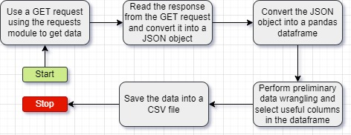
Data Collection – SpaceX API
To collect data, we use the requests module in Python to make API calls to different endpoints at api.spacexdata.com.
The Jupyter notebook for this task can be found at this link.

Slide 9
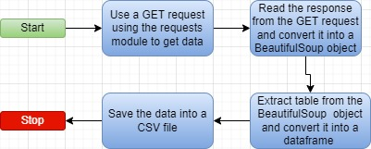
Data Collection - Scraping
To get Falcon 9 data using web scraping, we scraped data from Wikipedia page “List of Falcon 9 and Falcon heavy launches”. Then we extracted data from tables on the page into a CSV file.
The Jupyter notebook for data collection with web scraping can be found at this link.

Slide 10
Data Wrangling
After collecting the data, we performed data wrangling to get basic insights from the data and transform it into a usable format. For this, we performed the following tasks.
Calculate the number of launches on each site.
Calculate the number and occurrence of each orbit
Calculate the number and occurrence of mission outcome of the orbits
Create a landing outcome label from Outcome column for building classification models.
The Jupyter notebook for this task can be found at this link.

Slide 11
EDA with Data Visualization
After data wrangling, we proceeded with data visualization to find answers to our queries on how different factors affect the success of rocket landings.
To visualize the relationship between success rate of each orbit type, we used a bar chart.
To Visualize the relationships between Payload and Orbit type, Flight Number and Orbit type, Flight Number and Launch Site, we used a scatter plot.
To visualize the launch success yearly trend, we used a line chart.
The Jupyter Notebook for this task can be found at this link.

Slide 12
EDA with SQL
After data visualization, we used SQL to gain deeper insights into the data. For this, we used the following queries.
Display the names of the unique launch sites in the space mission
Display 5 records where launch sites begin with the string 'CCA'
Display the total payload mass carried by boosters launched by NASA (CRS)
Display average payload mass carried by booster version F9 v1.1
List the date when the first successful landing outcome in ground pad was achieved.
List the names of the boosters which have success in drone ship and have payload mass greater than 4000 but less than 6000.
List the total number of successful and failure mission outcomes
List the names of the booster versions which have carried the maximum payload mass
List the records which will display the month names, failure landing outcomes in drone ship ,booster versions, launch site for the months in year 2015.
Rank the count of landing outcomes (such as Failure (drone ship) or Success (ground pad)) between the date 2010-06-04 and 2017-03-20, in descending order.
The Jupyter Notebook for the task can be found at this link.

Slide 13
Build an Interactive Map with Folium
To build interactive maps with Folium, I completed the following tasks.
Mark all launch sites on a map.
Mark the success/failed launches for each site on the map.
Calculate the distances between a launch site to its proximities
For this, I used different folium objects such as Map to create the map object, Circle to add a highlighted circle area with a text label on a specific coordinate, Marker to mark a particular coordinate, and MarkerCluster to group multiple markers.
The Jupyter notebook for this activity can be found at this link.

Slide 14
Build a Dashboard with Plotly Dash
To get better insights into the data, I created a dashboard to visualize the success vs failed launches for each SpaceX launch site. It also uses a pie chart to show the total successful launches count for all sites. I have also used a scatter chart to show the correlation between payload and launch success for each site.
The Python file for this activity can be found at this link.

Slide 15
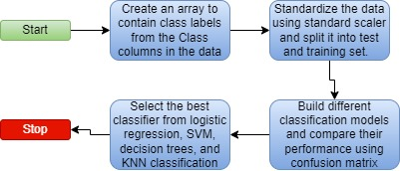
Predictive Analysis (Classification)
To build a classification model, we first created an array to contain class labels. Then, we used standard scaling algorithm to standardize the data. Next, we used different algorithms such as Logistic regression, Support vector machines, decision trees, and K-Nearest Neighbors algorithm to find the best classifier for predicting whether a rocket launch and landing will successful or not based on different factors. The Jupyter notebook for this activity can be found at this link.

Slide 16
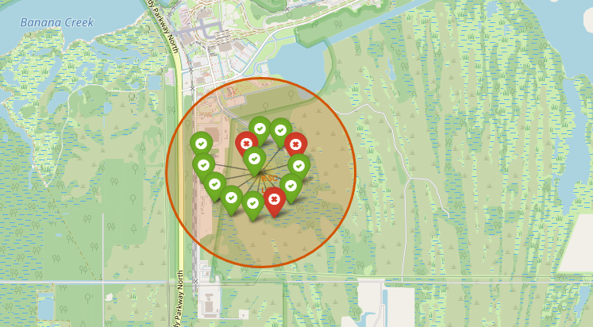
Results
In the next sections, we discuss the outcomes of Exploratory data analysis, Interactive analytics, and Predictive analysis.

Slide 17

Section 2

Slide 18
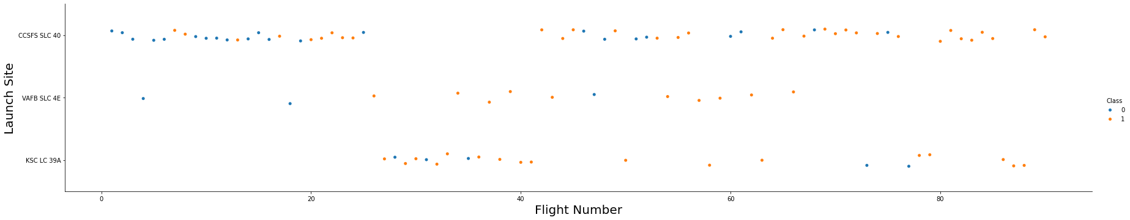
Flight Number vs. Launch Site
The analysis on Flight Number vs Launch site shows that the site CCSFS SLC 40 was used to launch majority of rockets and VAFB SLC 4E was used to launch the least number of rockets as shown in the below scatter plot.

Slide 19
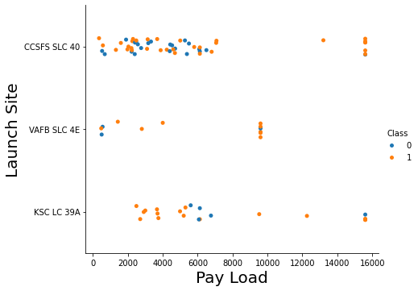
Payload vs. Launch Site
The scatter plot on payload vs Launch site shows that the site CCSFS SLC 40 launched most of the rockets with payload less than 8000 Kgs. The site KSC LC 39A launched most of the rockets with payloads between 2000 to 7000 Kgs.

Slide 20
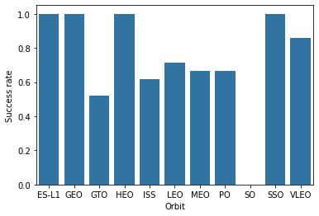
Success Rate vs. Orbit Type
The bar chart on success rate vs orbit type shows that launches to 4 orbits namely ES-L1, GEO, HEO, and SSO have 100 percent success rate whereas launches to SO have 0 percent success rate.

Slide 21
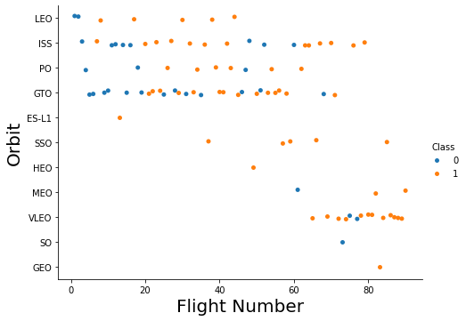
Flight Number vs. Orbit Type
The scatter on Flight number vs Orbit type shows tat most of the launches are for LEO, ISS, PO, AND GTO. On the other hand, orbits ES-L1, HEO, SO, and GEO have only one launch.

Slide 22
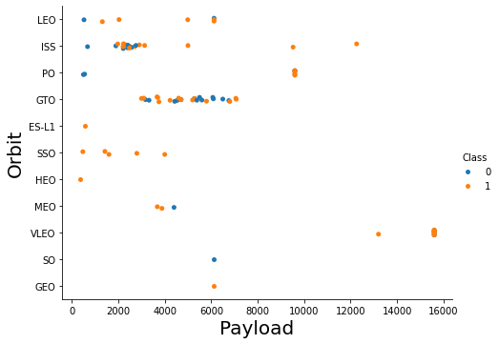
Payload vs. Orbit Type
The scatter plot on payload vs orbit type shows that most of the launches are of less than 10000 kg payload.
The ISS orbit has most launches between 3000 to 5000 kg whereas the GTO orbit has payloads in the 3000 to 8000 kg range.
The VLEO orbit has two flights with 16000 kg payload.

Slide 23
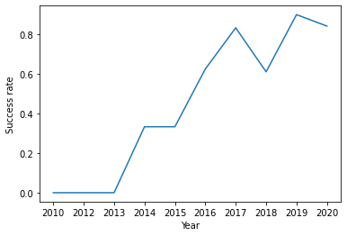
Launch Success Yearly Trend
The line chart for launch success yearly trend shows that SpaceX had no success in landing the first stage of rockets till 2013. After that, it has significantly increased its success rate each year, with a slight dip in the year 2018.

Slide 24
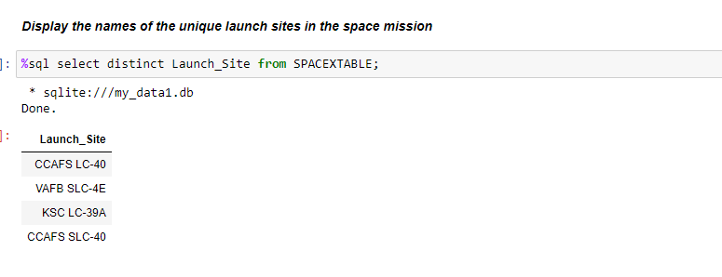
All Launch Site Names
To get the all launch site names, we have used distinct keyword with the select statement. The results are as follows.

Slide 25
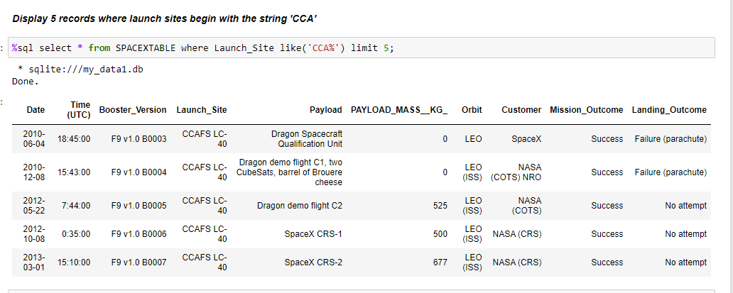
Launch Site Names Begin with 'CCA'
To find 5 records where launch sites begin with `CCA`, I have used the like() operator and the limit keyword to get only 5 rows.

Slide 26
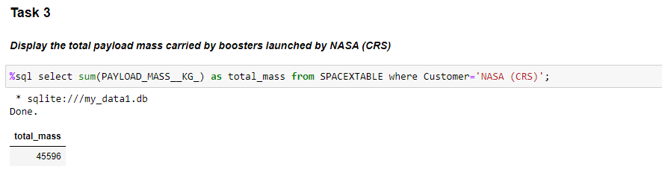
Total Payload Mass
To calculate the total payload carried by boosters from NASA, I have used the where keyword and the sum() function.

Slide 27
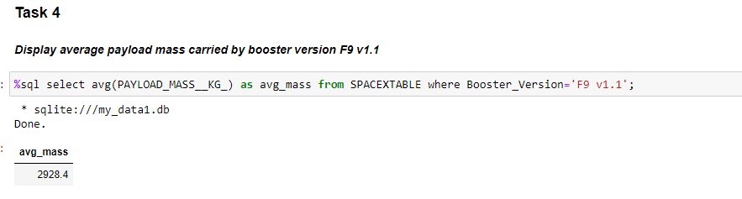
Average Payload Mass by F9 v1.1
To calculate the average payload mass carried by booster version F9 v1.1, I have used the avg() function and where operation with the select statement.

Slide 28
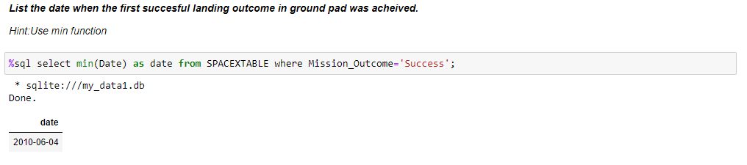
First Successful Ground Landing Date
To find the date of the first successful landing outcome on ground pad, I have used the min() function and the where condition.

Slide 29
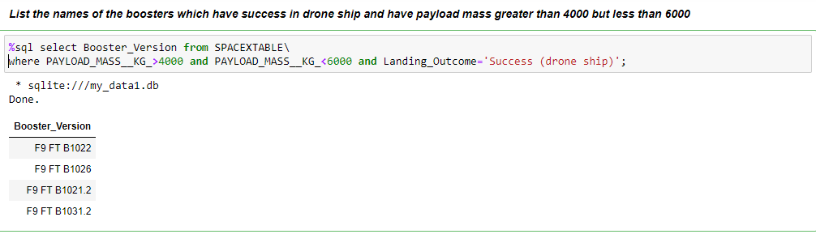
Successful Drone Ship Landing with Payload between 4000 and 6000
To list the names of boosters which have successfully landed on drone ship and had payload mass greater than 4000 but less than 6000, I have used the and operator in the where condition to apply required conditions.

Slide 30
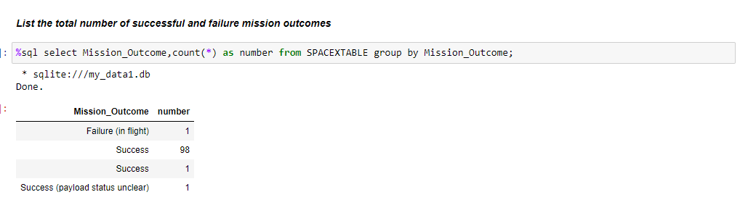
Total Number of Successful and Failure Mission Outcomes
To calculate the total number of successful and failure mission outcomes, I have used the groupby() function with the count() function.

Slide 31
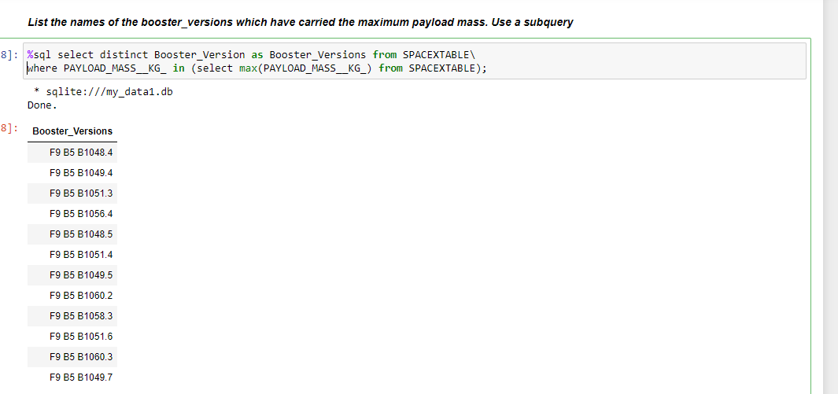
Boosters Carried Maximum Payload
To list the names of the booster which have carried the maximum payload mass, I have used a subquery to first get the maximum payload. Then, I used the where condition with distinct operation to get the desired results.

Slide 32
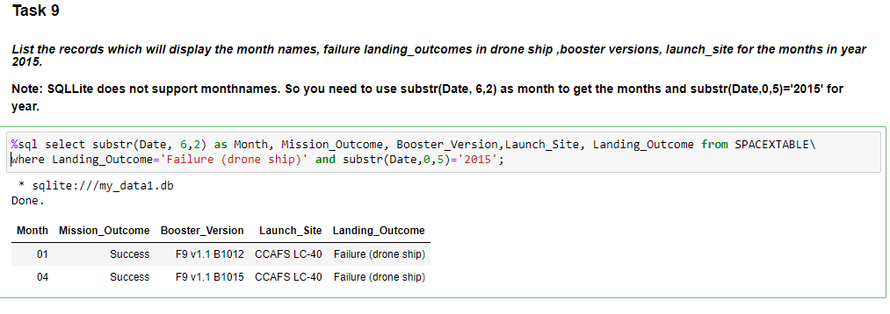
2015 Launch Records
To list the failed landing_outcomes in drone ship, their booster versions, and launch site names for in year 2015, I used the substr() function to get the launch year and used it in the where condition and the select statement.

Slide 33
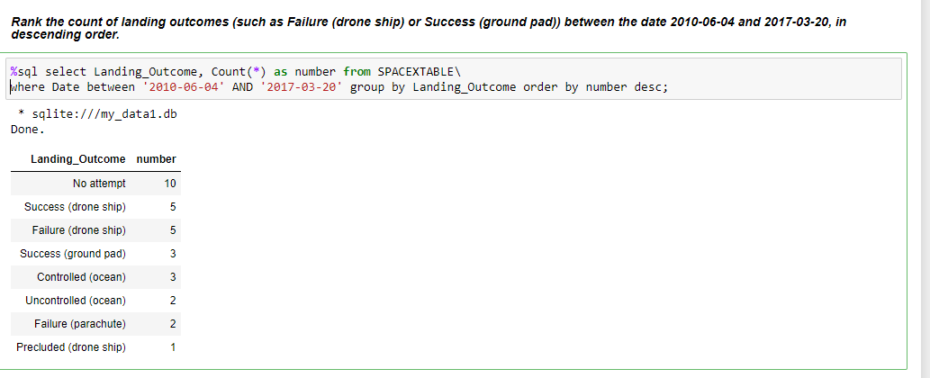
Rank Landing Outcomes Between 2010-06-04 and 2017-03-20
To rank the count of landing outcomes (such as Failure (drone ship) or Success (ground pad)) between the date 2010-06-04 and 2017-03-20, in descending order, I have used order by operation and the count() function.

Slide 34

Section 3

Slide 35
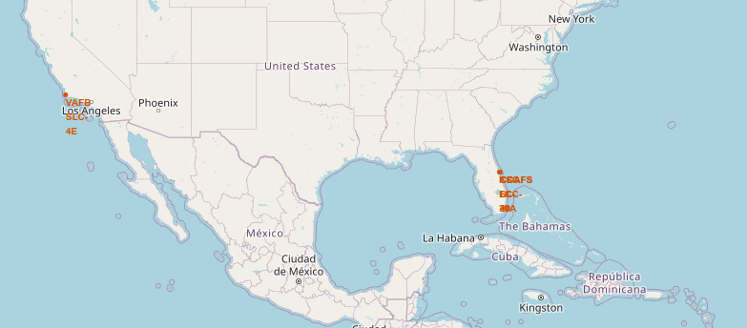
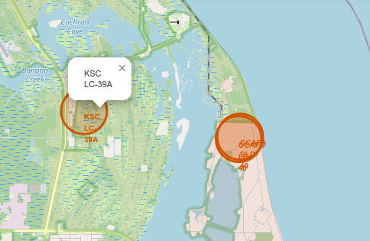
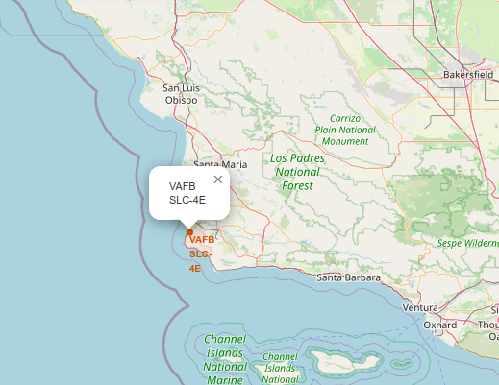
SpaceX Launch Sites
As we can see, all the launch sites are in coastal regions close to the equator. This helps SpaceX launch rockets efficiently and land the first stage of rockets into water bodies.

Slide 36
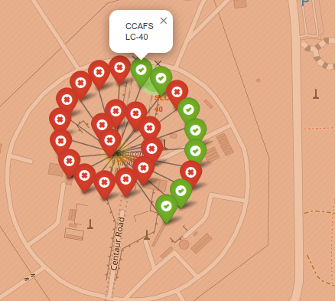
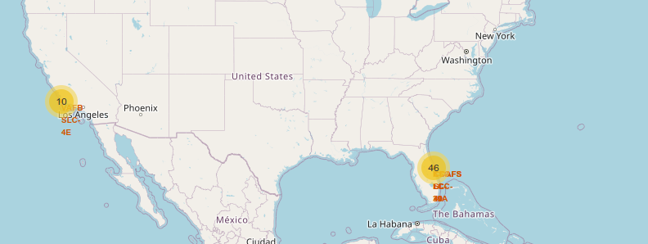
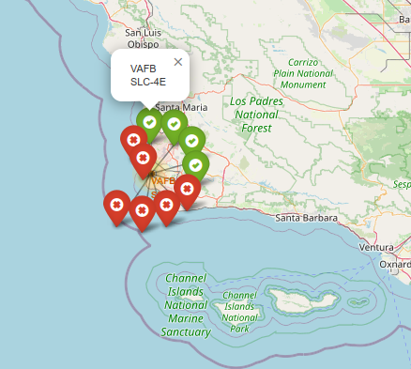
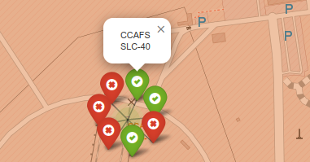
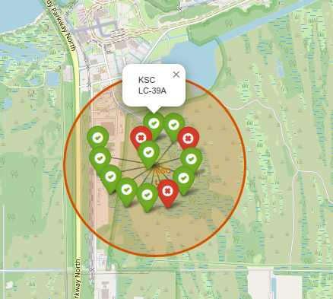
Success vs Failed Launches by SpaceX
In the output map, we can observe that the site CCAFS LC-40 has a low success rate whereas the site KSC LC-39A has a high success rate.

Slide 37
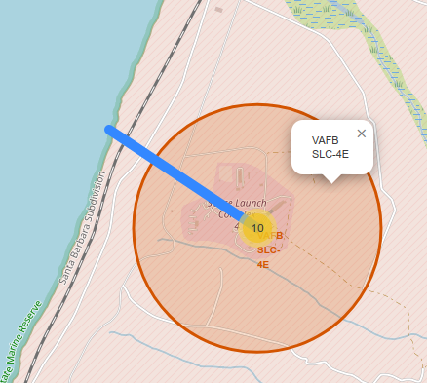
Nearest Coastline to VAFB SLC-4E
In the output map, we can see that the nearest coastline to the Launchpad VAFB SLC-4E is only 1.3 KMs away.

Slide 38

Section 4

Slide 39
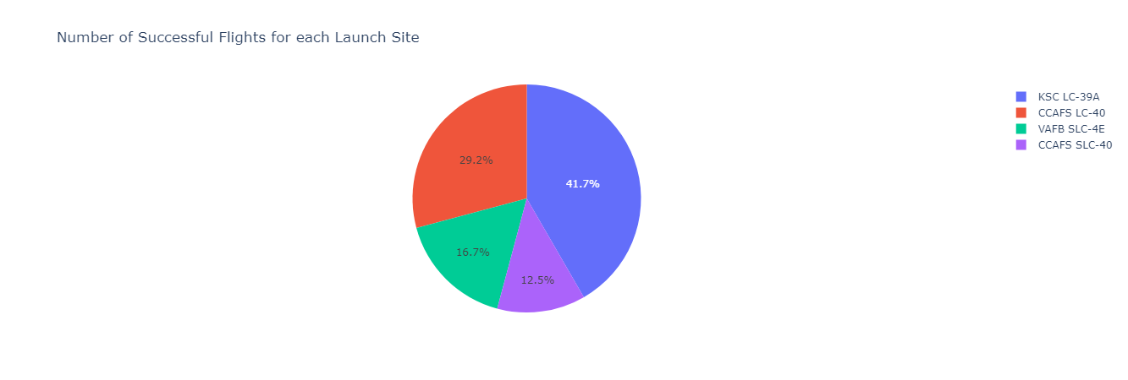
'Number of Successful Flights for each Launch Site'
The pie chart shows that the launch site KSC LC-39-A has highest percentage of successful flight. On the contrary, the launch site CCAFS SLC-40 has the lowest number of successful flights.

Slide 40
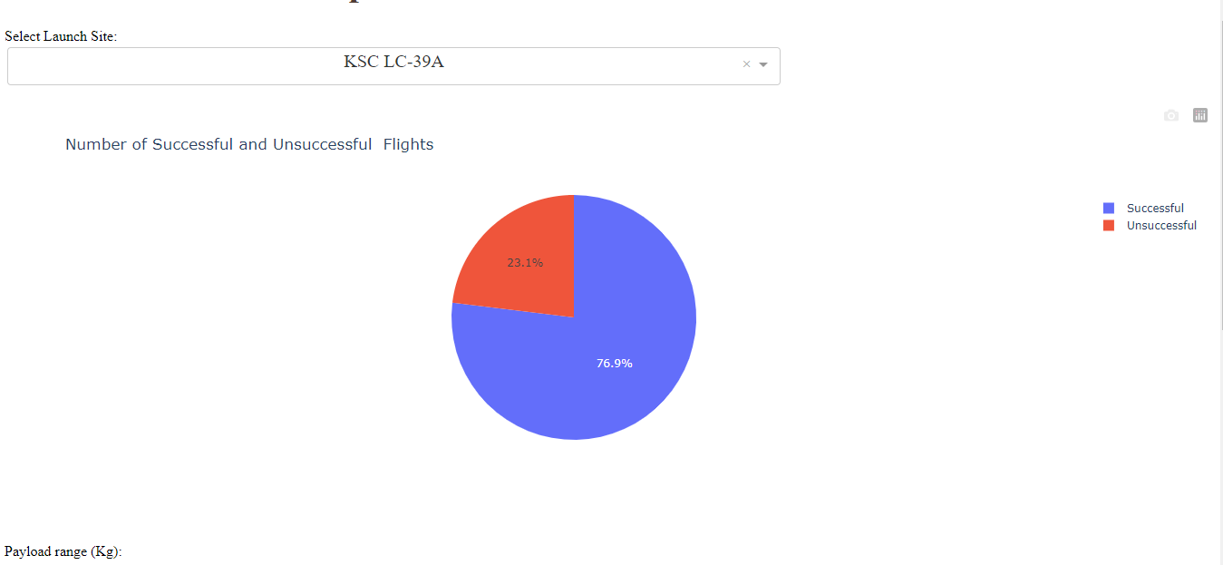
Percentage of Successful and Unsuccessful flights at KSC LC-39A
The launch site KSC LC-39A has the highest success percentage at 6.9 percent.

Slide 41
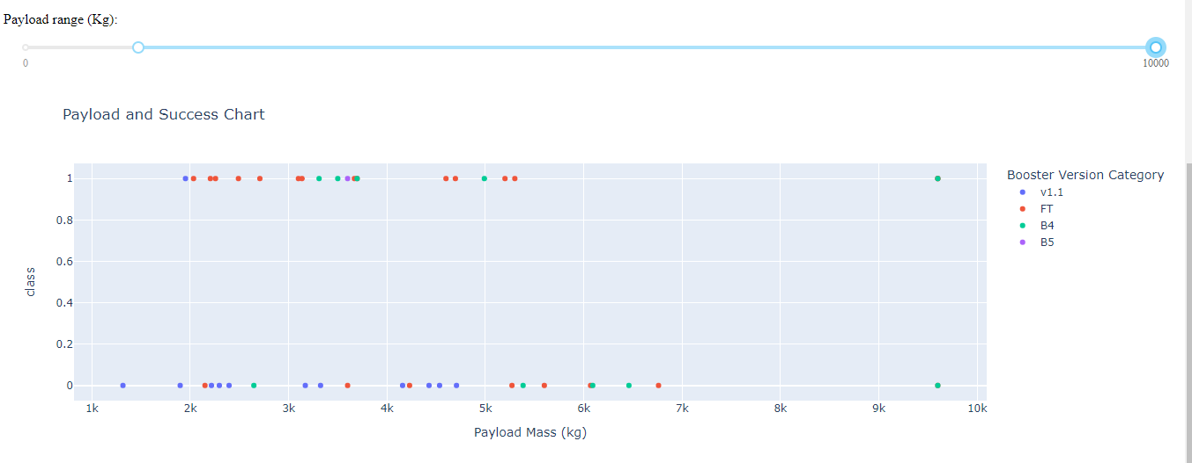
Payload and Success Chart
In the output plot, we can observe that the booster version FT has the highest overall success rate.

Slide 42

Section 5

Slide 43
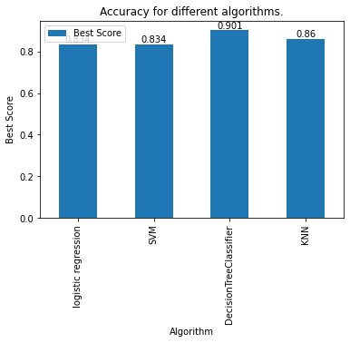
Classification Accuracy
By looking at the bar chart, we can observe that the decision tree classifier has the highest accuracy on training data whereas the logistic regression and the SVM classifier have the lowest accuracy.
On the test data, All the models showed the same accuracy.

Slide 44
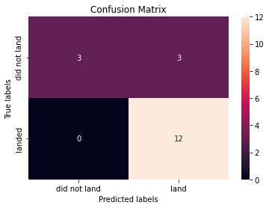
Confusion Matrix
On the test data, all the models showed similar results as captured in the confusion matrix.

Slide 45


